Slide 1

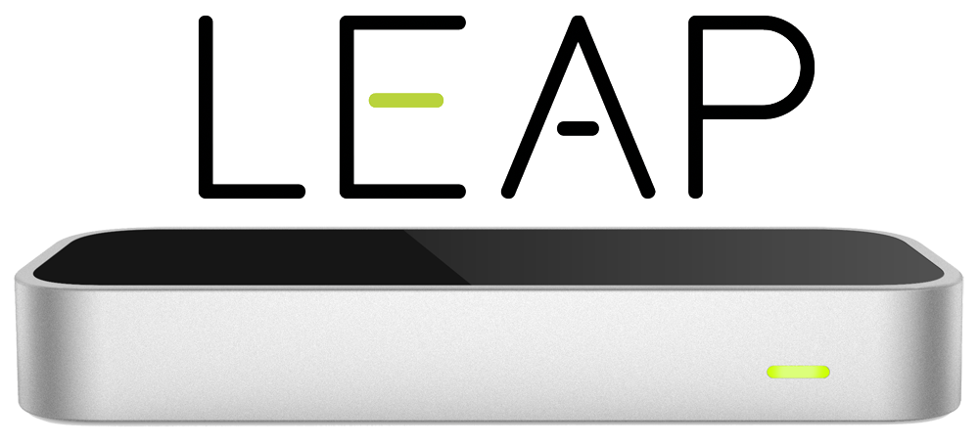
Project Design Presentation
Students: Matt Raporte, Greg Potter
Customer: Professor Huang, Professor Chuah

Slide 2
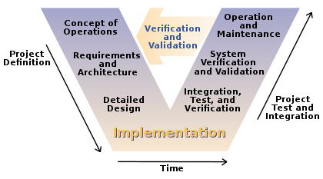
3 Part Component Organization
Why?
Detection
Translation
Action
Component testing
Ability to work on different components individually, works with our schedules
Extensibility, simplicity.. etc (Design Requirement, CSE216)

Slide 3
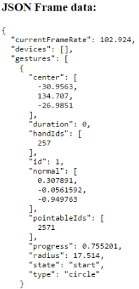


Detection:

Slide 4
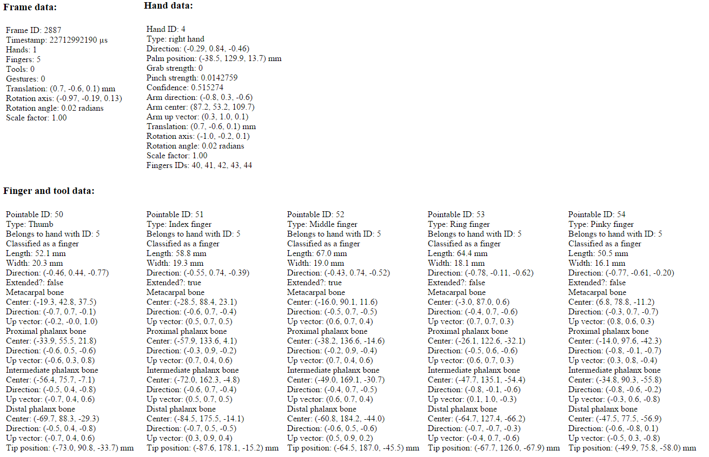
Detection:
available raw data

Slide 5
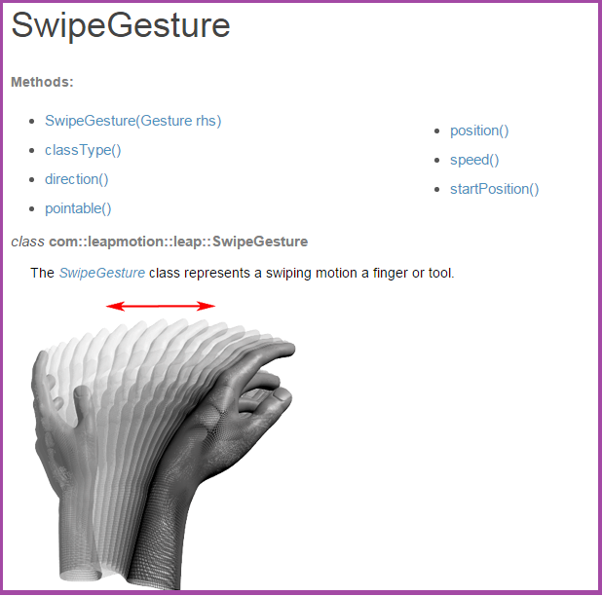

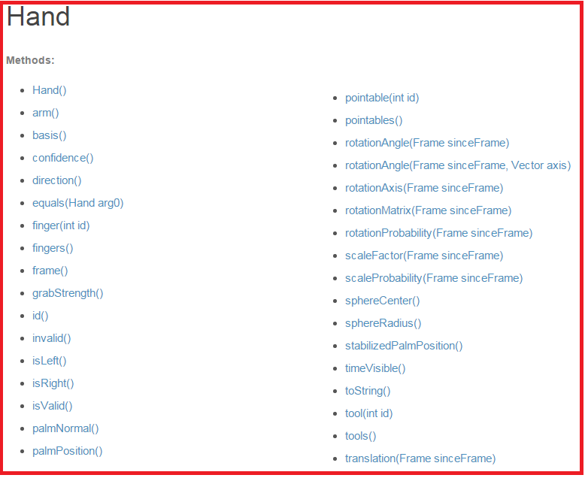
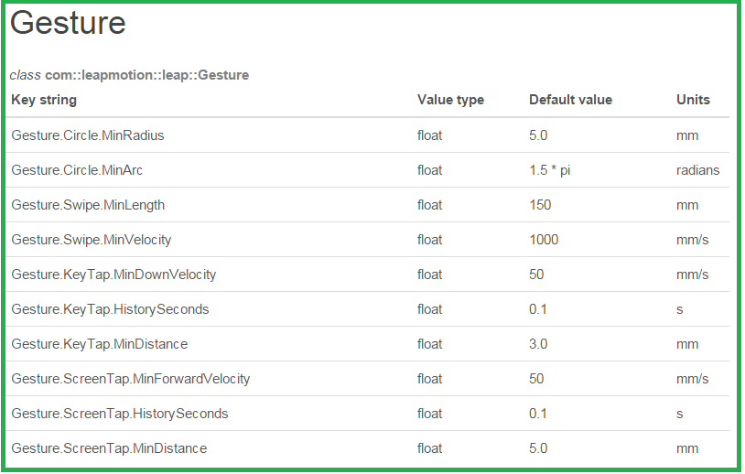
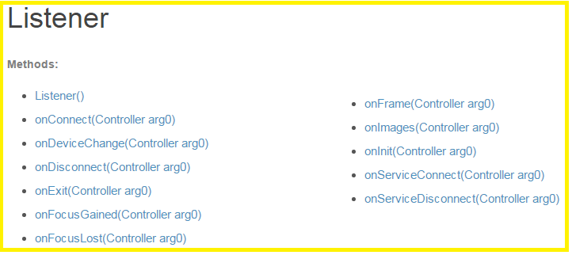

Detection:
but we are
encountering
issues..
Also in the library:
CircleGesture
ScreenTapGesture
KeyTapGesture
.. These all work extremely well and could be reverse engineered to define our own Gestures using a similar protocol?

Slide 6
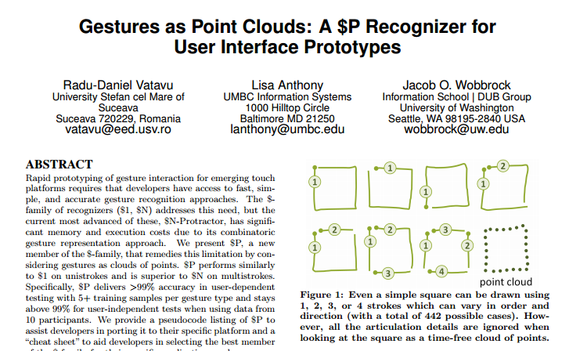
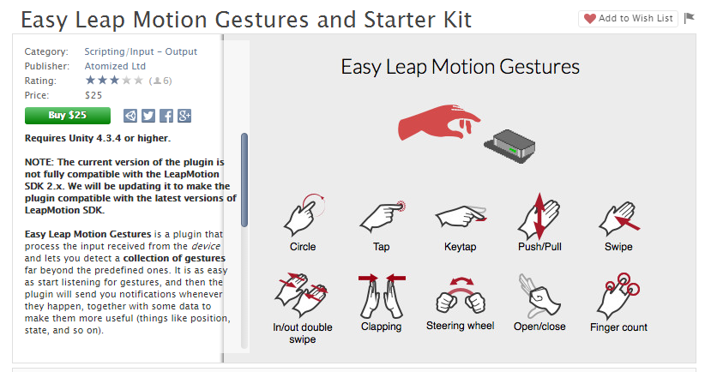
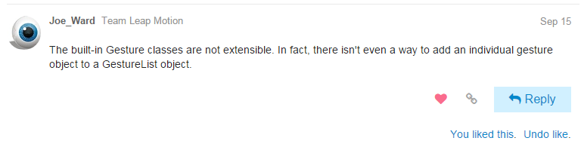
Detection: issue

Slide 7
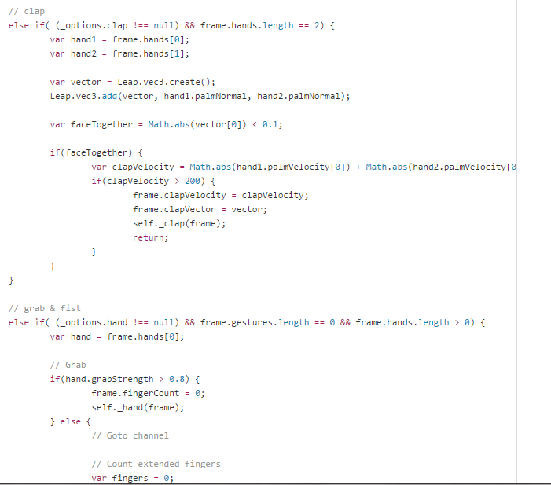
Detection: Solution
Detection: Solution?
Detection:
issues with this approach...
1) Has to be very rigorously defined and tested to avoid false-positive detection.
-Can you guess one way to enduce a false-positive detection in "clap"?
-Theres so much raw data to work with.. what’s relevant and what isn’t?
2) At the same time, we have to avoid false-negatives (detection fail)..
-Start and stop boundaries for relevant movement raw-data have to be defined very carefully
-Tools to help with this:
•Leap Motion live data feeds
•Computer visualization of our defined gestures
We will:
Make gesture recognizing in the leap motion thread (listener class / onframe method)
Make gesture processing / reaction in the main thread.
To do this..
Implement new gesture list where I put in all the detected gestures (own gestures) from the certain frame through onframe method.
-The gesture list is accessible from both threads and locked for synchronisation.
2) In the main thread take all the gestures from the gesture list that refer to the current frame processed in the main thread.

Slide 8
Detection:
Current Progress
1) Gotten built in Gestures to work. Most importantly, the “SwipeGesture” and it’s reverse will be used for advancing/retracting sildes.
Why?
•It’s the most used feature so it requires highest accuracy.
•Feels the most natural
.
2) Planned a Detection component architecture that will borrow as much as possible from Leap SDK in order to efficiently host our custom gestures
3) Logically defined, prototyped and tested base-level custom gestures
•Clap, fist, vertical wave, pinches
•Need to be further parameterized, current detection rate is 40%-60% for these
•need to consider how technological limitations when designing new gesture ideas
(ie “Finger” objects are non-persistent from frame to frame so we need new “FWD-X” and “BWD-X” movements
4) Researched: SDK documentation, LM forums, Open Source projects

Slide 9
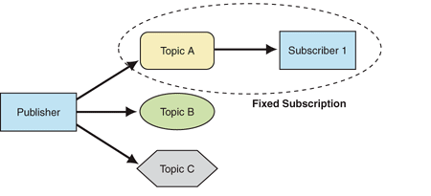
Translation:
This is an abstract component. Will most likely be triggered from within Detection, however it greatly affects our products final efficiency so we’re devoting a whole component to implementation.
Planning to use a Publisher/Subscriber pattern to drop the commands from Detection that can be picked up and the system will know what to do with it
Will use Microsoft Message Queueing (MSMQ) to handle this communication

Slide 10

Action:
Separately running application which ties into PowerPoint
Options/other config will be done by adding a button to PowerPoint “ribbon”
Subscribes to the “topic” from the Translate part
Uses the Microsoft VSTO Add-In API to control the PowerPoint presentation
SlideShowView object exposes methods such as:
Next(), Previous(), GoToSlide(int), DrawLine(...), and GoToClick(...)
So far we have the basic slide control working as per the “Prototype” phase

Slide 11
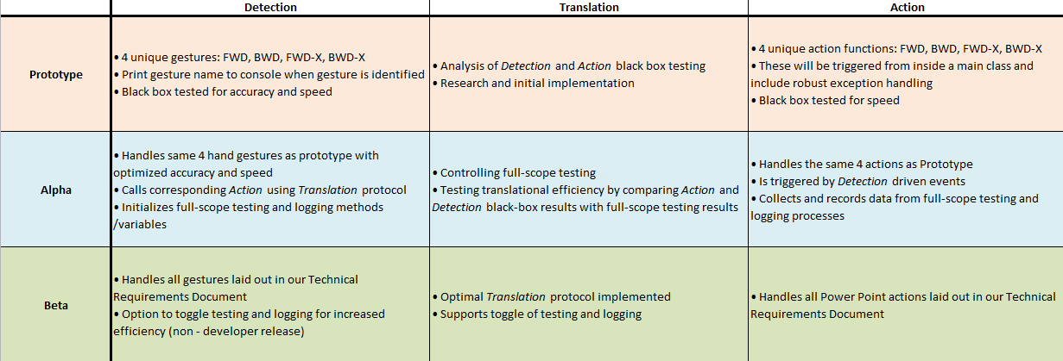
Stages of the Software Development Process

Slide 12


